Slide 1
Developing Apps for Touch and Mobile Devices

Slide 2
Objectives
In this session, you will learn to:
  Develop location-aware apps

Slide 3
Developing Location-Aware Apps
A number of apps are available that provide location-dependent information, such as weather information, local radio stations, and nearby railway stations, airports, or restaurants.
Location of an app can be accessed through following modes:
  GPS
  Wi-Fi
  IP
To create an effective location-aware app, you should know how to perform the following tasks:
  Detect the user's geographical location.
  Respond to location updates.
  Adjust the distance/time between location updates.
  Display the location on a map.

Slide 4
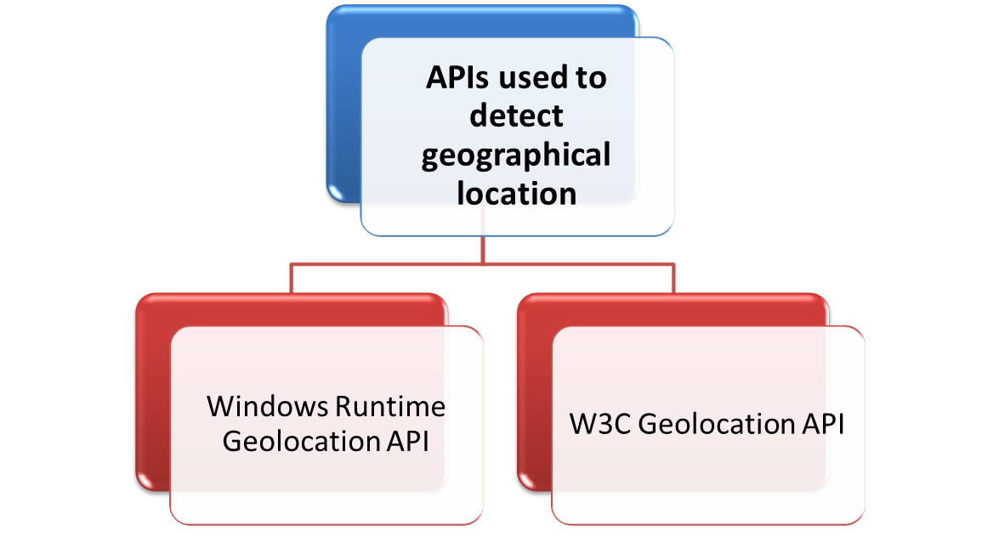
Developing Location-Aware Apps (Contd.)

Slide 5
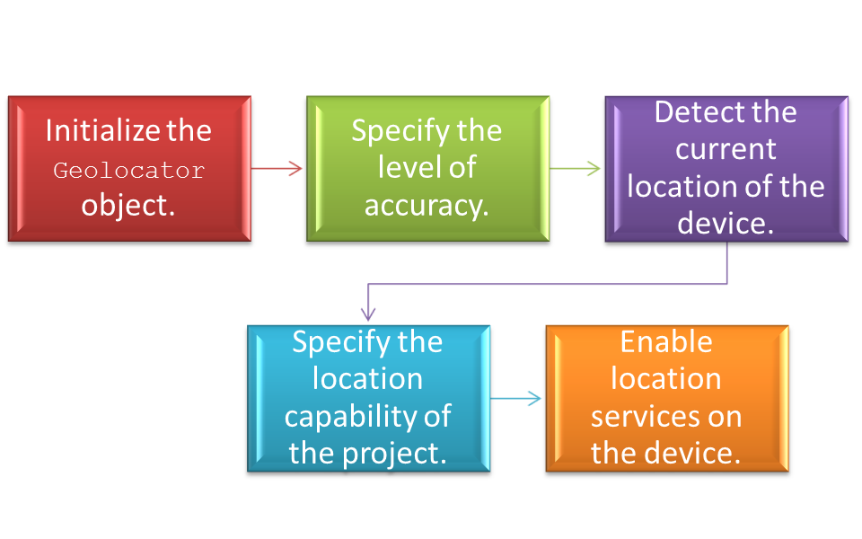
Detecting the User’s Geographical Location
Using the Windows Runtime Geolocation API
The Windows.Devices.Geolocation namespace is used to detect the user’s location, provides APIs to access the device’s geographic location.
Tasks performed using Windows.Devices.Geolocation namespace

Slide 6


Detecting the User’s Geographical Location (Contd.)
Initializing the Geolocator Object:
  To access the user’s current geographical location, you can use the Geolocator class of the Windows.Devices.Geolocation namespace.
  To access the geographic data, initialize a Geolocator object as:
Specifying the Level of Accuracy:
  To provide a high level of accuracy, set the DesiredAccuracy property of the object of the Geolocator class to High.
  To set the DesiredAccuracy property:
  var location = new Windows.Devices.Geolocation.Geolocator();
  location.DesiredAccuracy = Windows.Devices.Geolocation.PositionAccuracy.High;

Slide 7

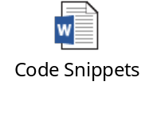
Detecting the User’s Geographical Location (Contd.)
Detecting the Current Location of the Device:
  The getGeoPositionAsync() method is used detect the current geographical location of the device.
  The getGeoPositionAsync() method once is sufficient for apps that use the device’s location for a single-time task, such as tagging a message with the location.
  The getGeoPositionAsync() method can be called using the following code snippet:
  Refer the following code snippets to understand how to detect the current location of the device.
  location.getGeopositionAsync().then(successHandler,errorHandler);

Slide 8
Detecting the User’s Geographical Location (Contd.)
Specifying the Location Capability of the Project:
  While developing a location-aware app, you need to declare the location capability in the package.appxmanifest file of the project.
  In absence of location capability, the app will not access the location data.
Enabling Location Services on the Device:
  On some devices, location services are enabled by default, whereas on others, users need to enable these services.
  If a user tries to use a location-aware app on a device on which the location services are disabled, the user will be prompted to enable the location services to use the app.

Slide 9

Task 8.1: Specifying the Location Capability of the Project

Slide 10
Task 8.2: Enabling Location Services on the Device

Slide 11
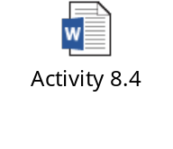
Activity 8.4: Detecting User’s Location Using the Windows Runtime Geolocation API
Problem Statement:
Solution:
To complete this activity, you need to perform the following steps:
  Design the UI of the app.
  Determines geographical coordinates.
  Execute the app.

Slide 12
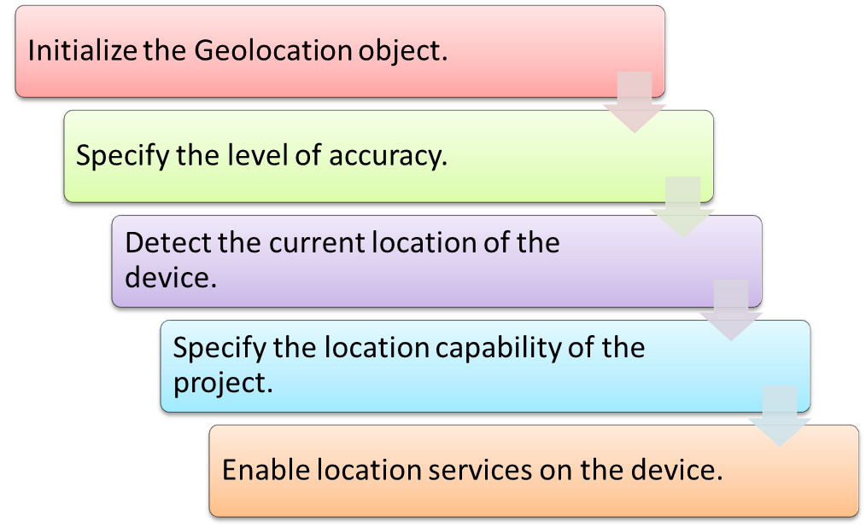
Detecting the User’s Geographical Location (Contd.)
Using the W3C Geolocation API
The window.navigator namespace is used to detect the user’s location, it provides APIs to access the device’s geographical location.
The following tasks need to be performed to detect the user’s location using the window.navigator namespace:

Slide 13

Detecting the User’s Geographical Location (Contd.)
Initializing the Geolocation Object:
  The Geolocation class of the window.navigator namespace is used to access the user’s current geographical location.
  You can unitize a geolocationobject is using the following code snippet:
Specifying the Level of Accuracy:
  The PositionOptions interface of the Geolocation API is used to provide the most accurate location data.
  The interface provides the following properties that you can specify while accessing the current geographical location of the device:
    PositionOptions.enableHighAccuracy
    PositionOptions.timeout
    PositionOptions.maximumAge
  var geoloc = window.navigator.geolocation;

Slide 14

Detecting the User’s Geographical Location (Contd.)
Detecting the Current Location of the Device:
  The current geographic location of the device can be detected by using window.navigator.geolocation.getCurrentPosition() method.
  You can use the getCurrentPosition()method by using following code snippet:
Refer the following code snippets to understand how to detect the current location of the device using W3C Geolocation API.
  geoloc.getCurrentPosition(successHandler, errorHandler, positionOptions);

Slide 15
Detecting the User’s Geographical Location (Contd.)
Specifying the Level of Accuracy:
  You need to specify the location capability of the project in the same way as you have specified while detecting the user’s location using the Windows Runtime Geolocation API.
Enable Location Services on the Device:
  If the services are disabled you should enable the location services on the device.

Slide 16
Activity 8.5: Detecting User’s Location Using the W3C Geolocation API
Problem Statement:
You have detected user’s geographical coordinates in Activity 8.4 using the Windows Runtime Geolocation API. Now, you need to implement the same functionality for a Windows app using the W3C Geolocation API.
Solution:
To complete this activity, you need to perform the following steps:
  Design the UI of the app.
  Determine geographical coordinates.
  Execute the app.

Slide 17
Responding to Location Updates
To detect the location of a device continuously, you need to enable your app to get location updates continuously.
To create apps such as, direction apps and weather apps , you need to respond to location updates when the position of the device or the status of the location data changes as these apps require constant location updates.

Slide 18
Responding to Location Updates (Contd.)
Using the Windows Runtime Geolocation API
To respond to location updates using the Windows Runtime Geolocation API, need to handle the following location events of the Geolocator class:
  Positionchanged
  Statuschanged
Refer the following code snippets to understand how to handle the preceding events, create an object of the Geolocator class and associate the event listeners for the events.

Slide 19

Responding to Location Updates (Contd.)
Using the W3C Geolocation API
The watchPosition()function is used to respond to the location updates using the W3C Geolocation API.
The watchPosition()is called each time the position of the user’s location changes and returns the user’s updated position as the user moves.
The getCurrentPosition(), the watchPosition() function accepts a success function, an optional error function, and an optional PositionOptions object.
The following code snippet shows how to use the watchPosition() function:
The clearWatch() function is used to stop watching the user’s location, as shown in the following code snippet:
  var watchID = navigator.geolocation.watchPosition(successHandler, errorHandler, positionOptions);
  navigator.geolocation.clearWatch(watchID);

Slide 20
Adjusting the Distance/Time Between Location Updates
Location-aware apps require location updates to provide the accurate location-based information to the users.
Some apps require frequent updates and others require updates after a specific interval of time or after a user moves to a specific distance.
According to the requirement of your app, you need to decide the distance movement between two successive location update events.

Slide 21

Adjusting the Distance/Time Between Location Updates (Contd.)
Using the Windows Runtime Geolocation API
The minimum distance that is required to raise the location update event is known as the movement threshold.
The MovementThreshold property of the Geolocator class helps to specify movement threshold for apps.
The following code snippet shows how to set the property, MovementThreshold:
The ReportInterval property of the Geolocator class can be used to raise the location update event after regular intervals of time.
  loc.MovementThreshold = 10;

Slide 22
Adjusting the Distance/Time Between Location Updates (Contd.)
Using the W3C Geolocation API
In W3C Geolocation API the movement threshold and interval between location updates cannot be set.
By setting the maximumAge property in the watchPosition()method, you can specify the duration for which a cached location will be used instead of retrieving the user’s current geographical location.

Slide 23

Displaying the Location on a Map
Google Maps is used to display the user’s location on a map, to first access a map service that is capable of identifying the location based on the latitude and longitude.
To include the Google Maps API, you need to write the following <script> tag in the default.js file (or any .js file) of your project:
  <script src="http://maps.google.com/maps/ api/js? sensor=true"></script>

Slide 24
Displaying the Location on a Map (Contd.)
Displaying the Map
Once included the Google Maps API, the app can display the map and represent the user’s location on it.
LatLng object is used to represent the user’s current location on the map.
Refer the following code snippets to understand how to create the LatLng object and map and specify the map options.
Types of maps available in Google APIs:
  Satellite
  Hybrid
  Terrain

Slide 25

Displaying the Location on a Map (Contd.)
Placing a Marker on the Map
After creating the map, you can indicate the user’s current location on it using a marker. You can create a marker using the following code snippet:
map specifies the element on which the marker will be displayed at the location specified using the position attribute.
  new google.maps.Marker({map: mapObject, position: userLatLng });

Slide 26
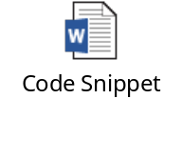
Displaying the Location on a Map (Contd.)
Creating a Circle to Represent Accuracy
Representing the accuracy of a location visually is more powerful than displaying it in a textual format.
Creating a circle around the user’s location over the map , indicates the accuracy to the users.
The fitBounds()method ensures that if the user zooms into the map and the circle goes outside the zoomed view, the map is zoomed out accordingly to display the entire circle.
Refer the following code snippet to understand how to create a circle.

Slide 27
Displaying the Location on a Map (Contd.)
Converting Latitude and Longitude into a Formatted Address
The displaying of latitude and longitude to users is quite meaningless, so to enable users to recognize their locations easily, we need to display the user’s formatted address.
The writeAddressName() function accepts the latLng object as a parameter and attempts to retrieve the geocoding information for the specified latitude and longitude.
Refer the following code snippet to understand how to display a formatted address to the users.

Slide 28

Just a Minute
Which one of the following types of maps is used to display a road map with satellite images?
1. Hybrid
2. Roadmap
3. Satellite
4. Terrain
Answer:
Hybrid

Slide 29
Activity 8.6: Displaying the Location on a Map
Problem Statement:
You are an app developer and have been asked to develop a Windows app that can determine the user’s location. You need to display the location in human readable text over a map so that it becomes easy for the users to know their current geographical location. Develop the app using the W3C Geolocation API.
Solution:
To complete this activity, you need to perform the following steps:
  Design the UI of the app.
  Determine geographical coordinates.
  Execute the app.

Slide 30
Summary
In this session, I learned that:

